Slide 1

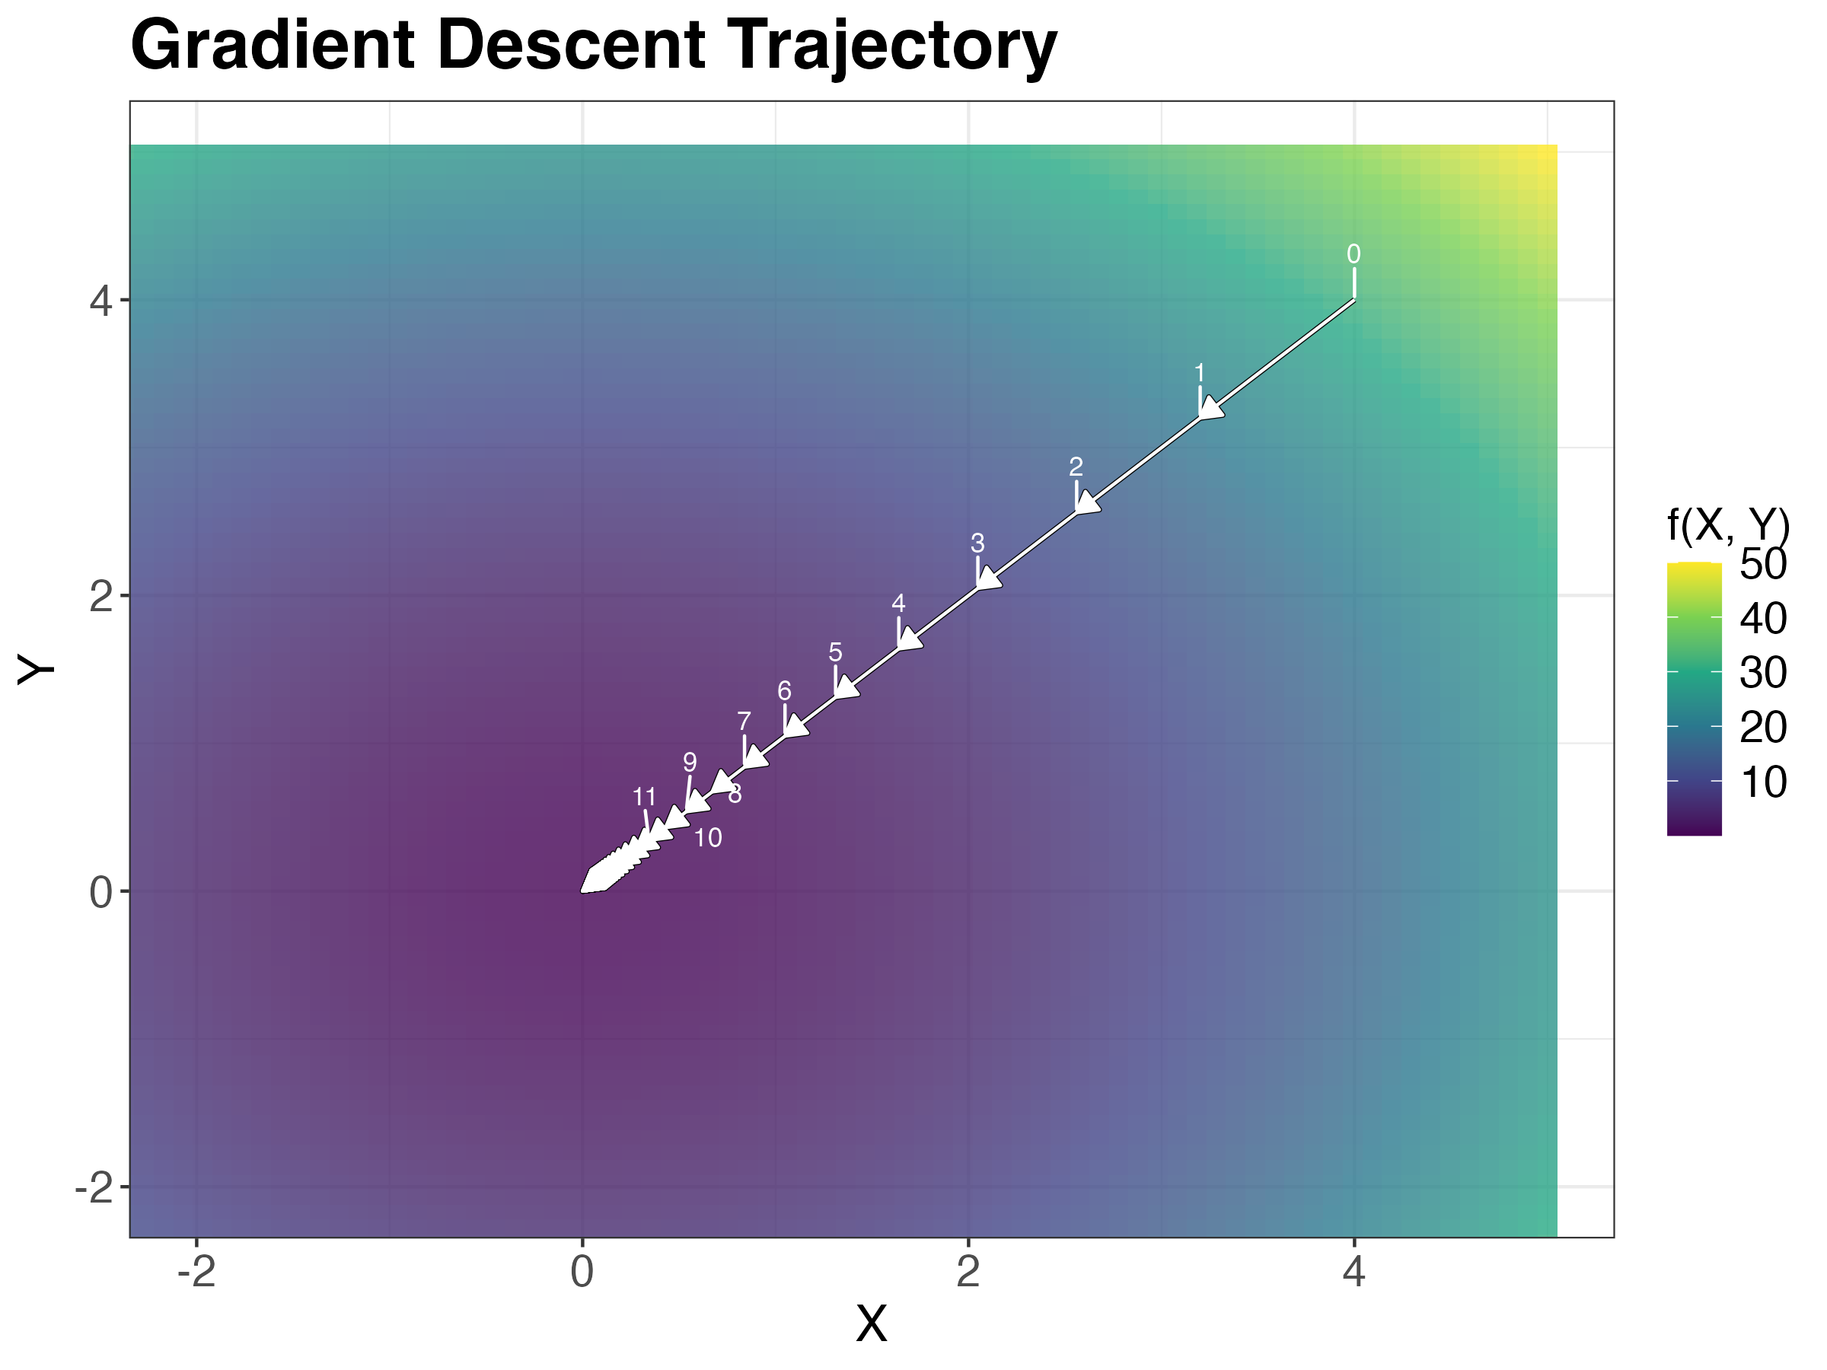
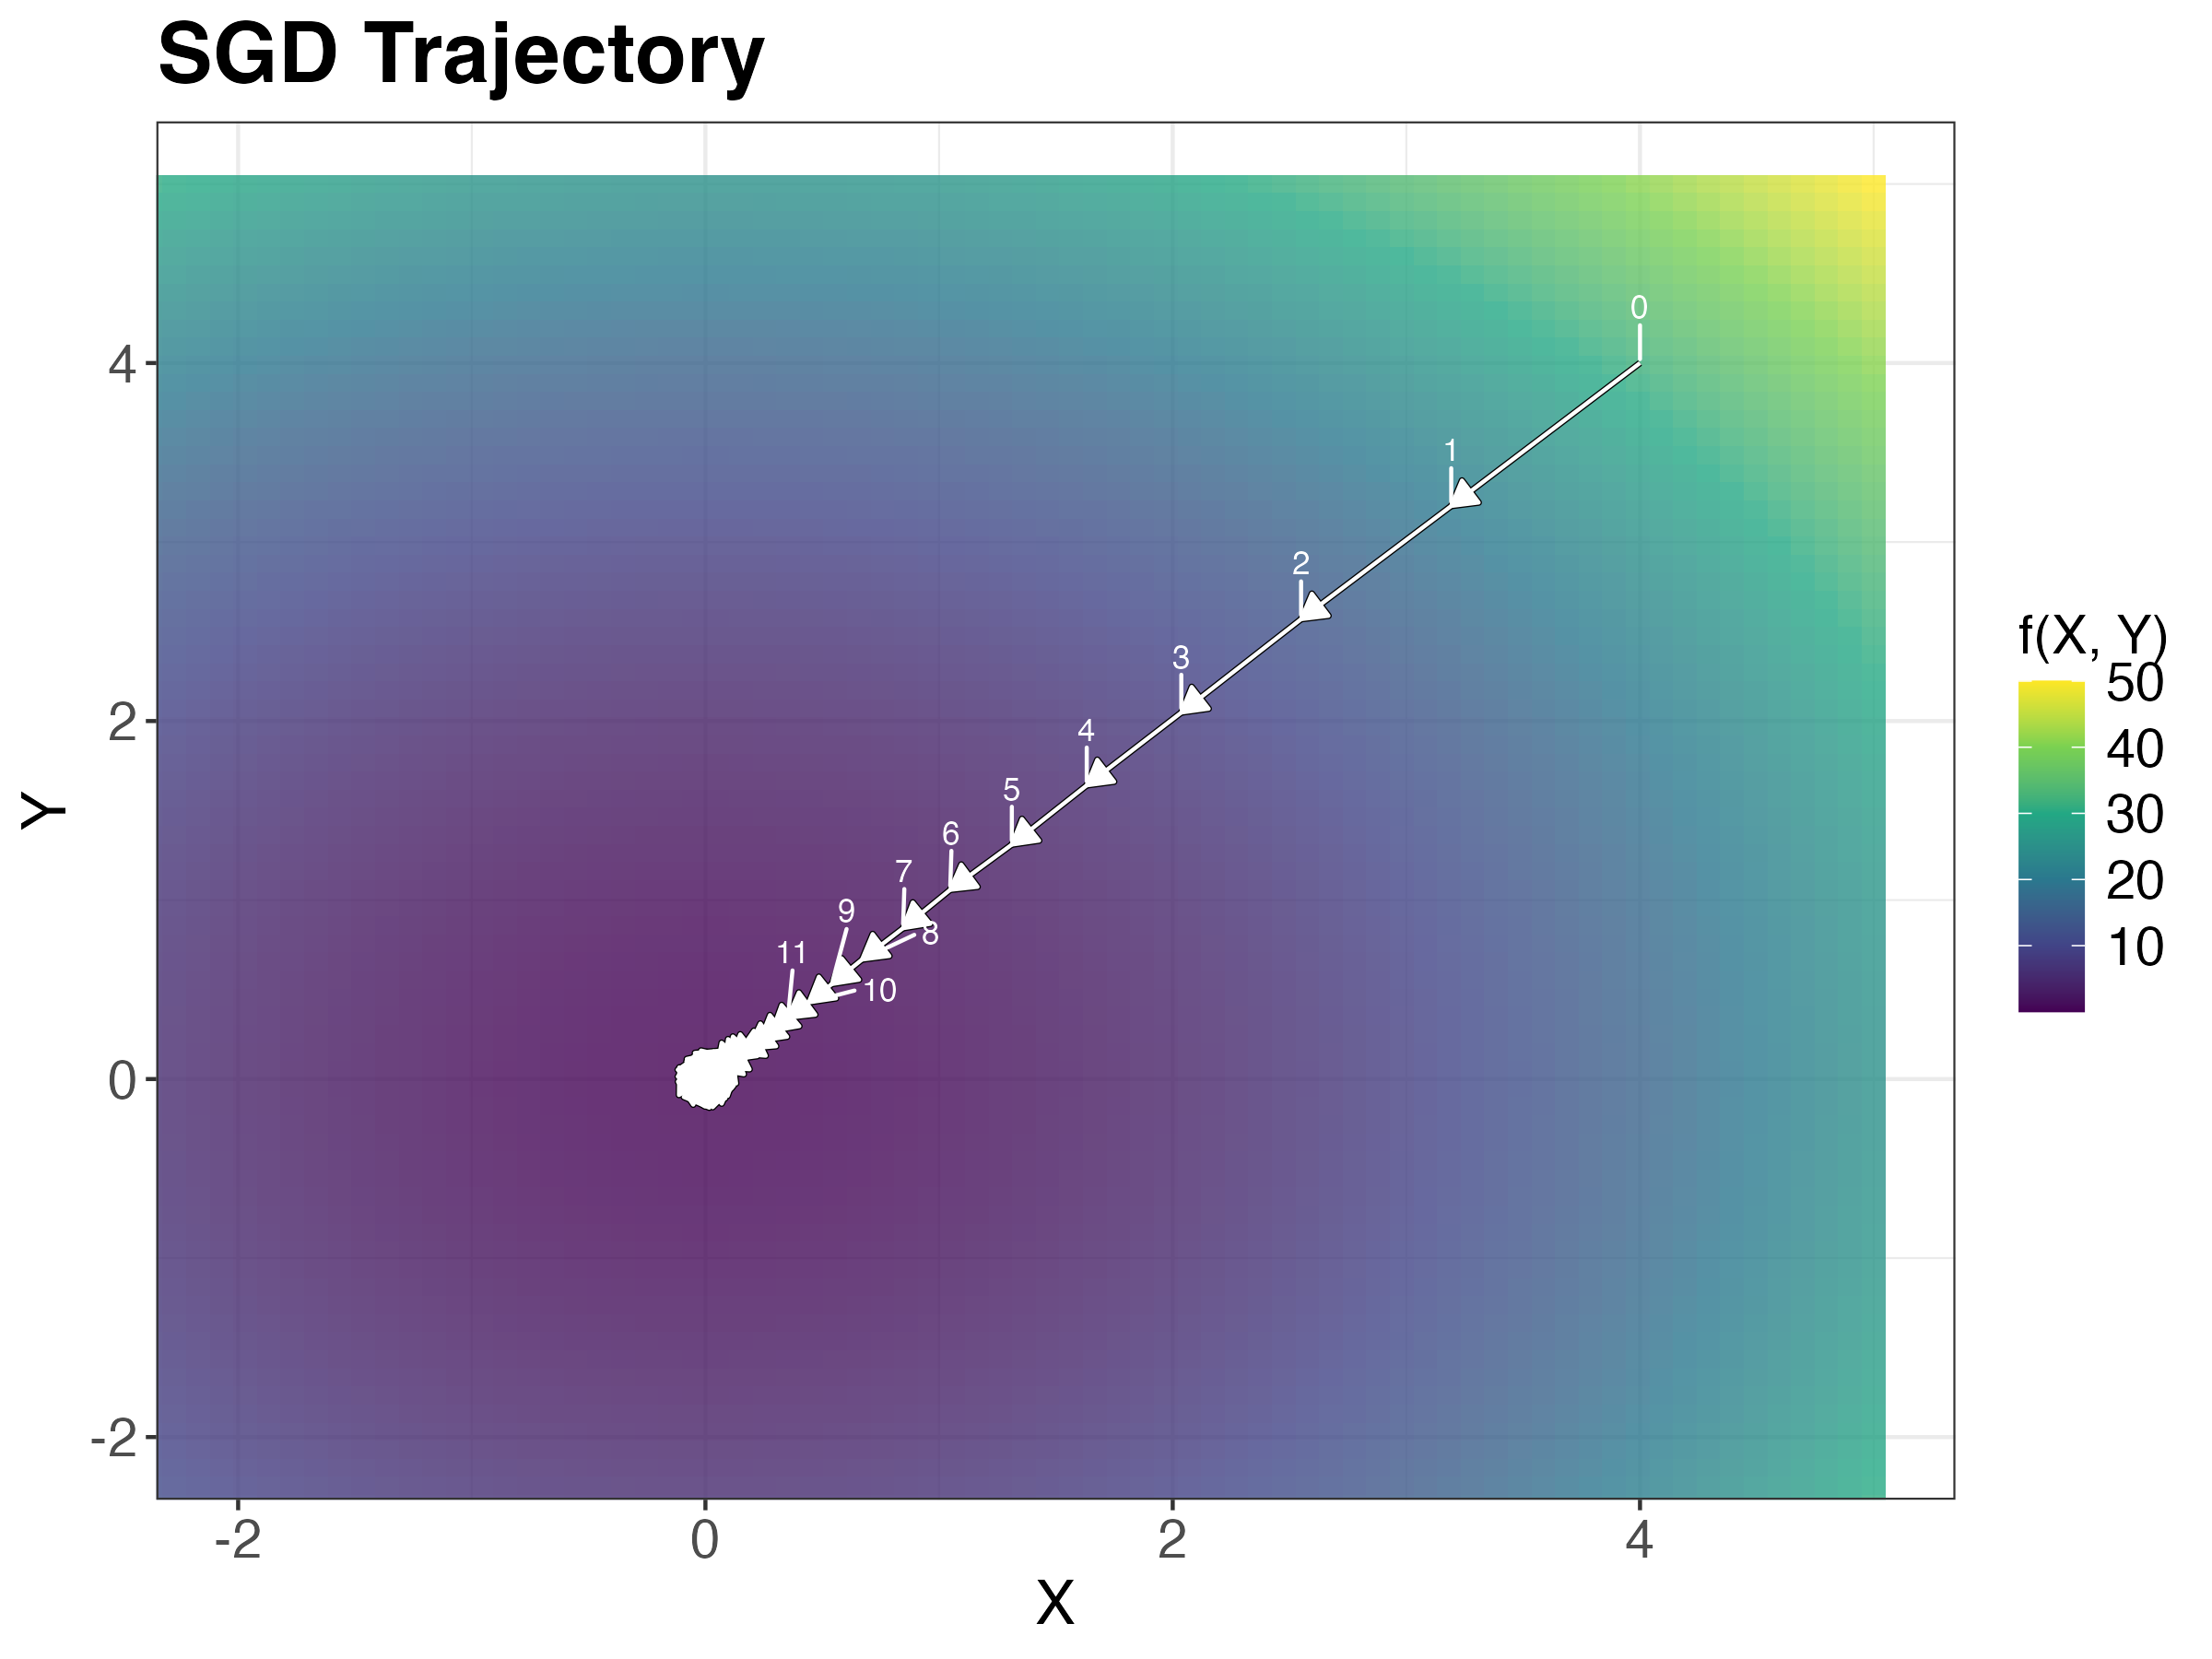
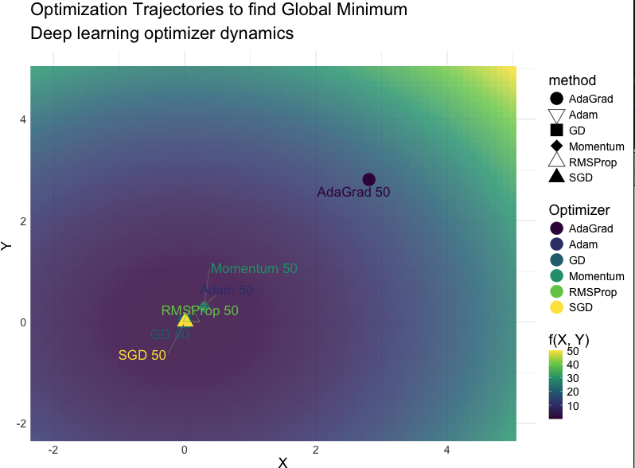
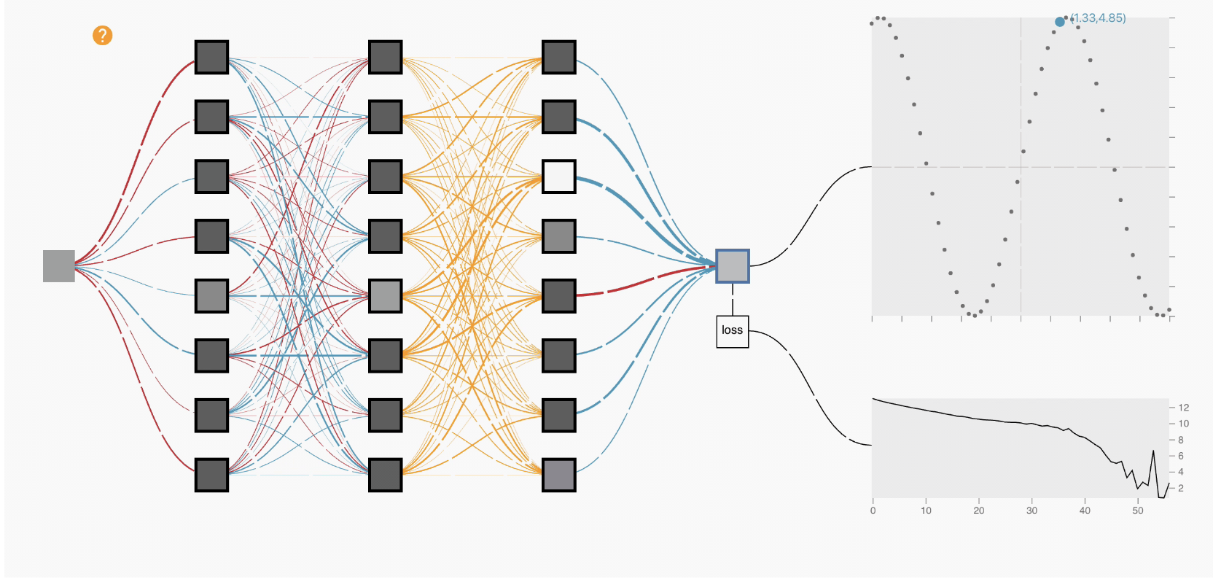
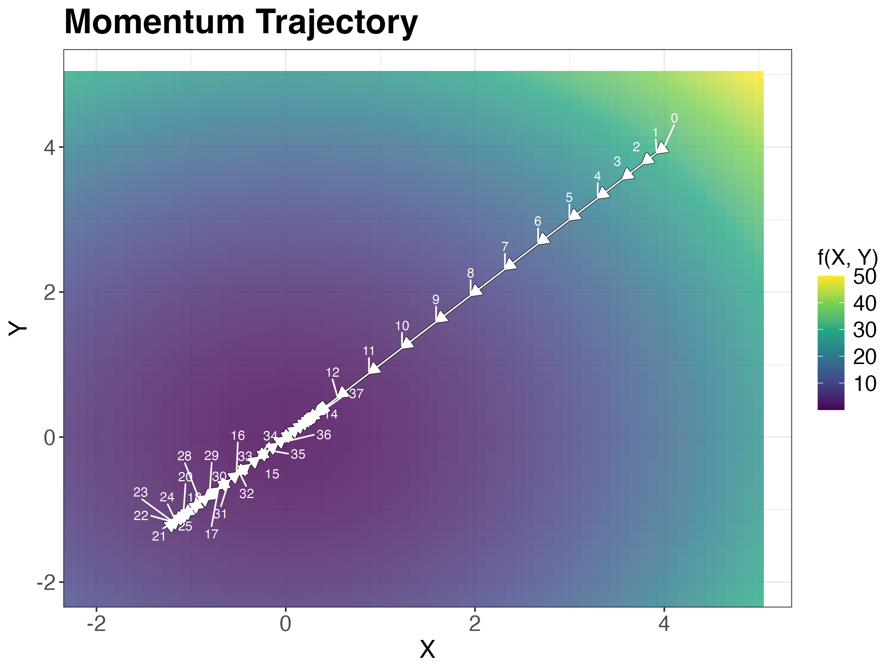
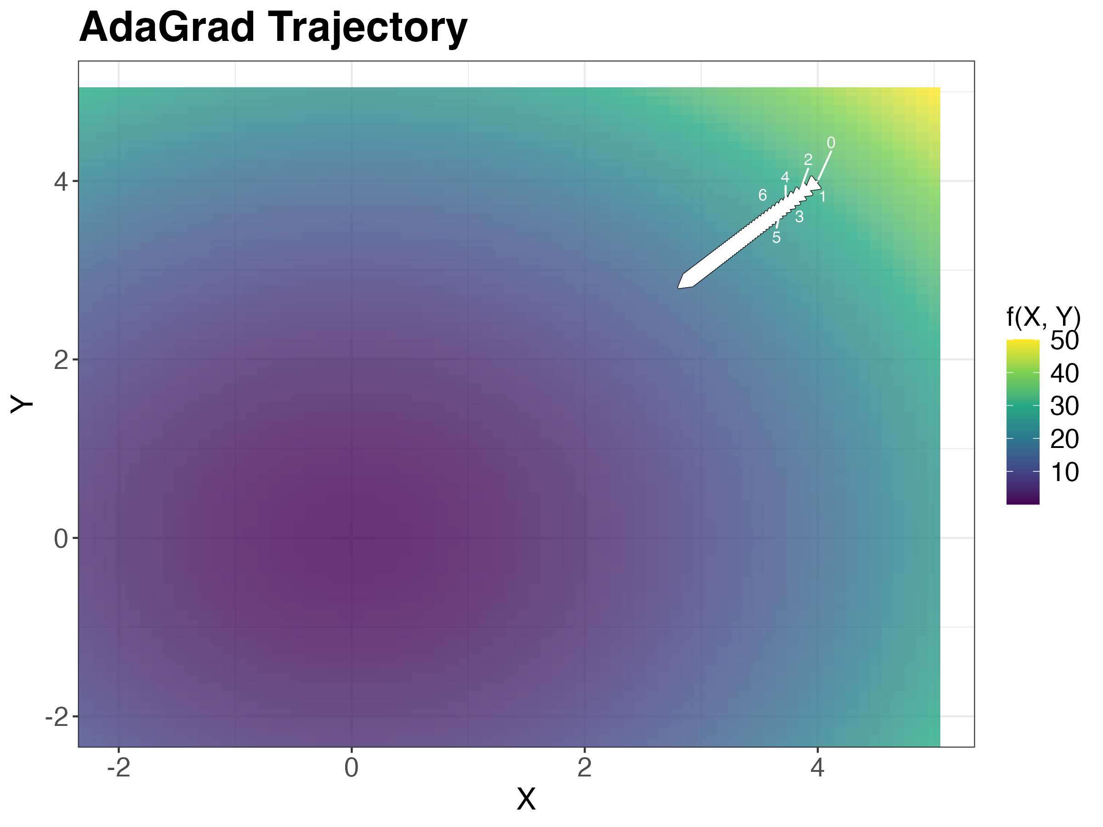
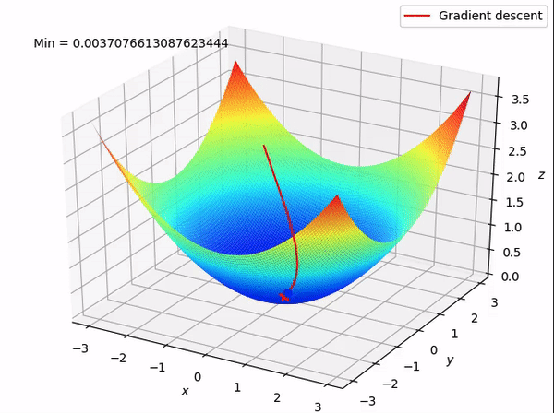
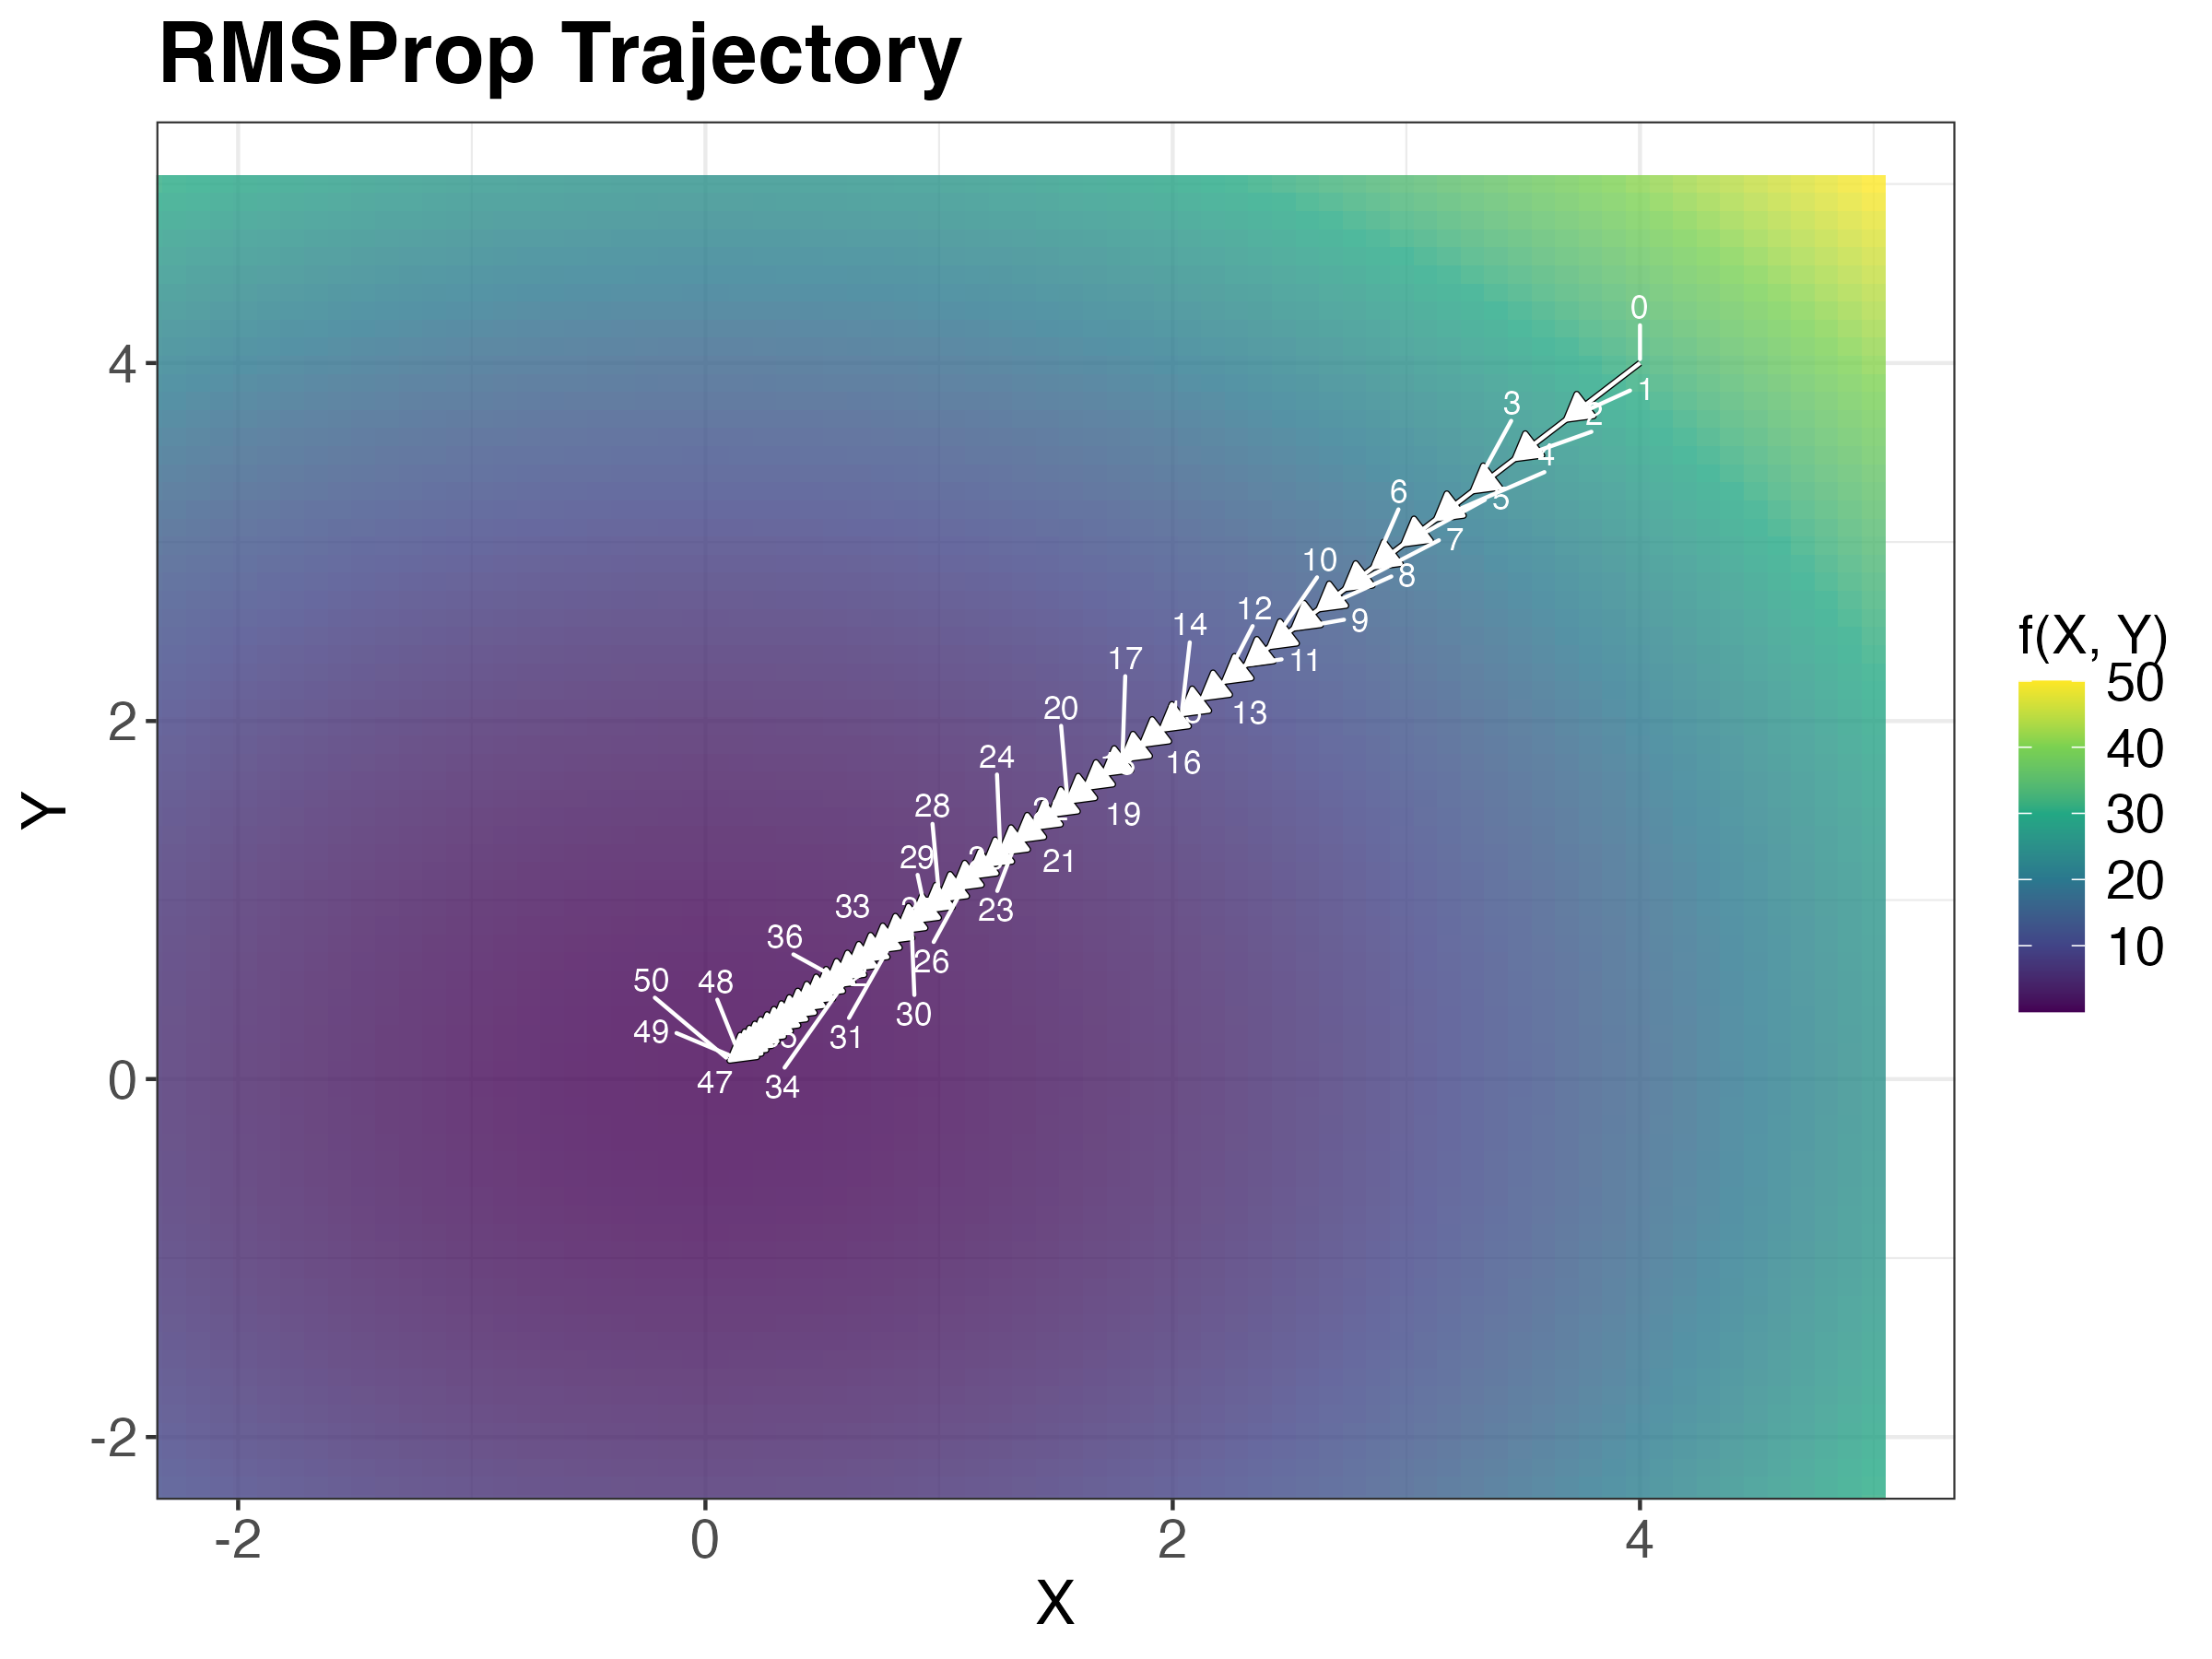
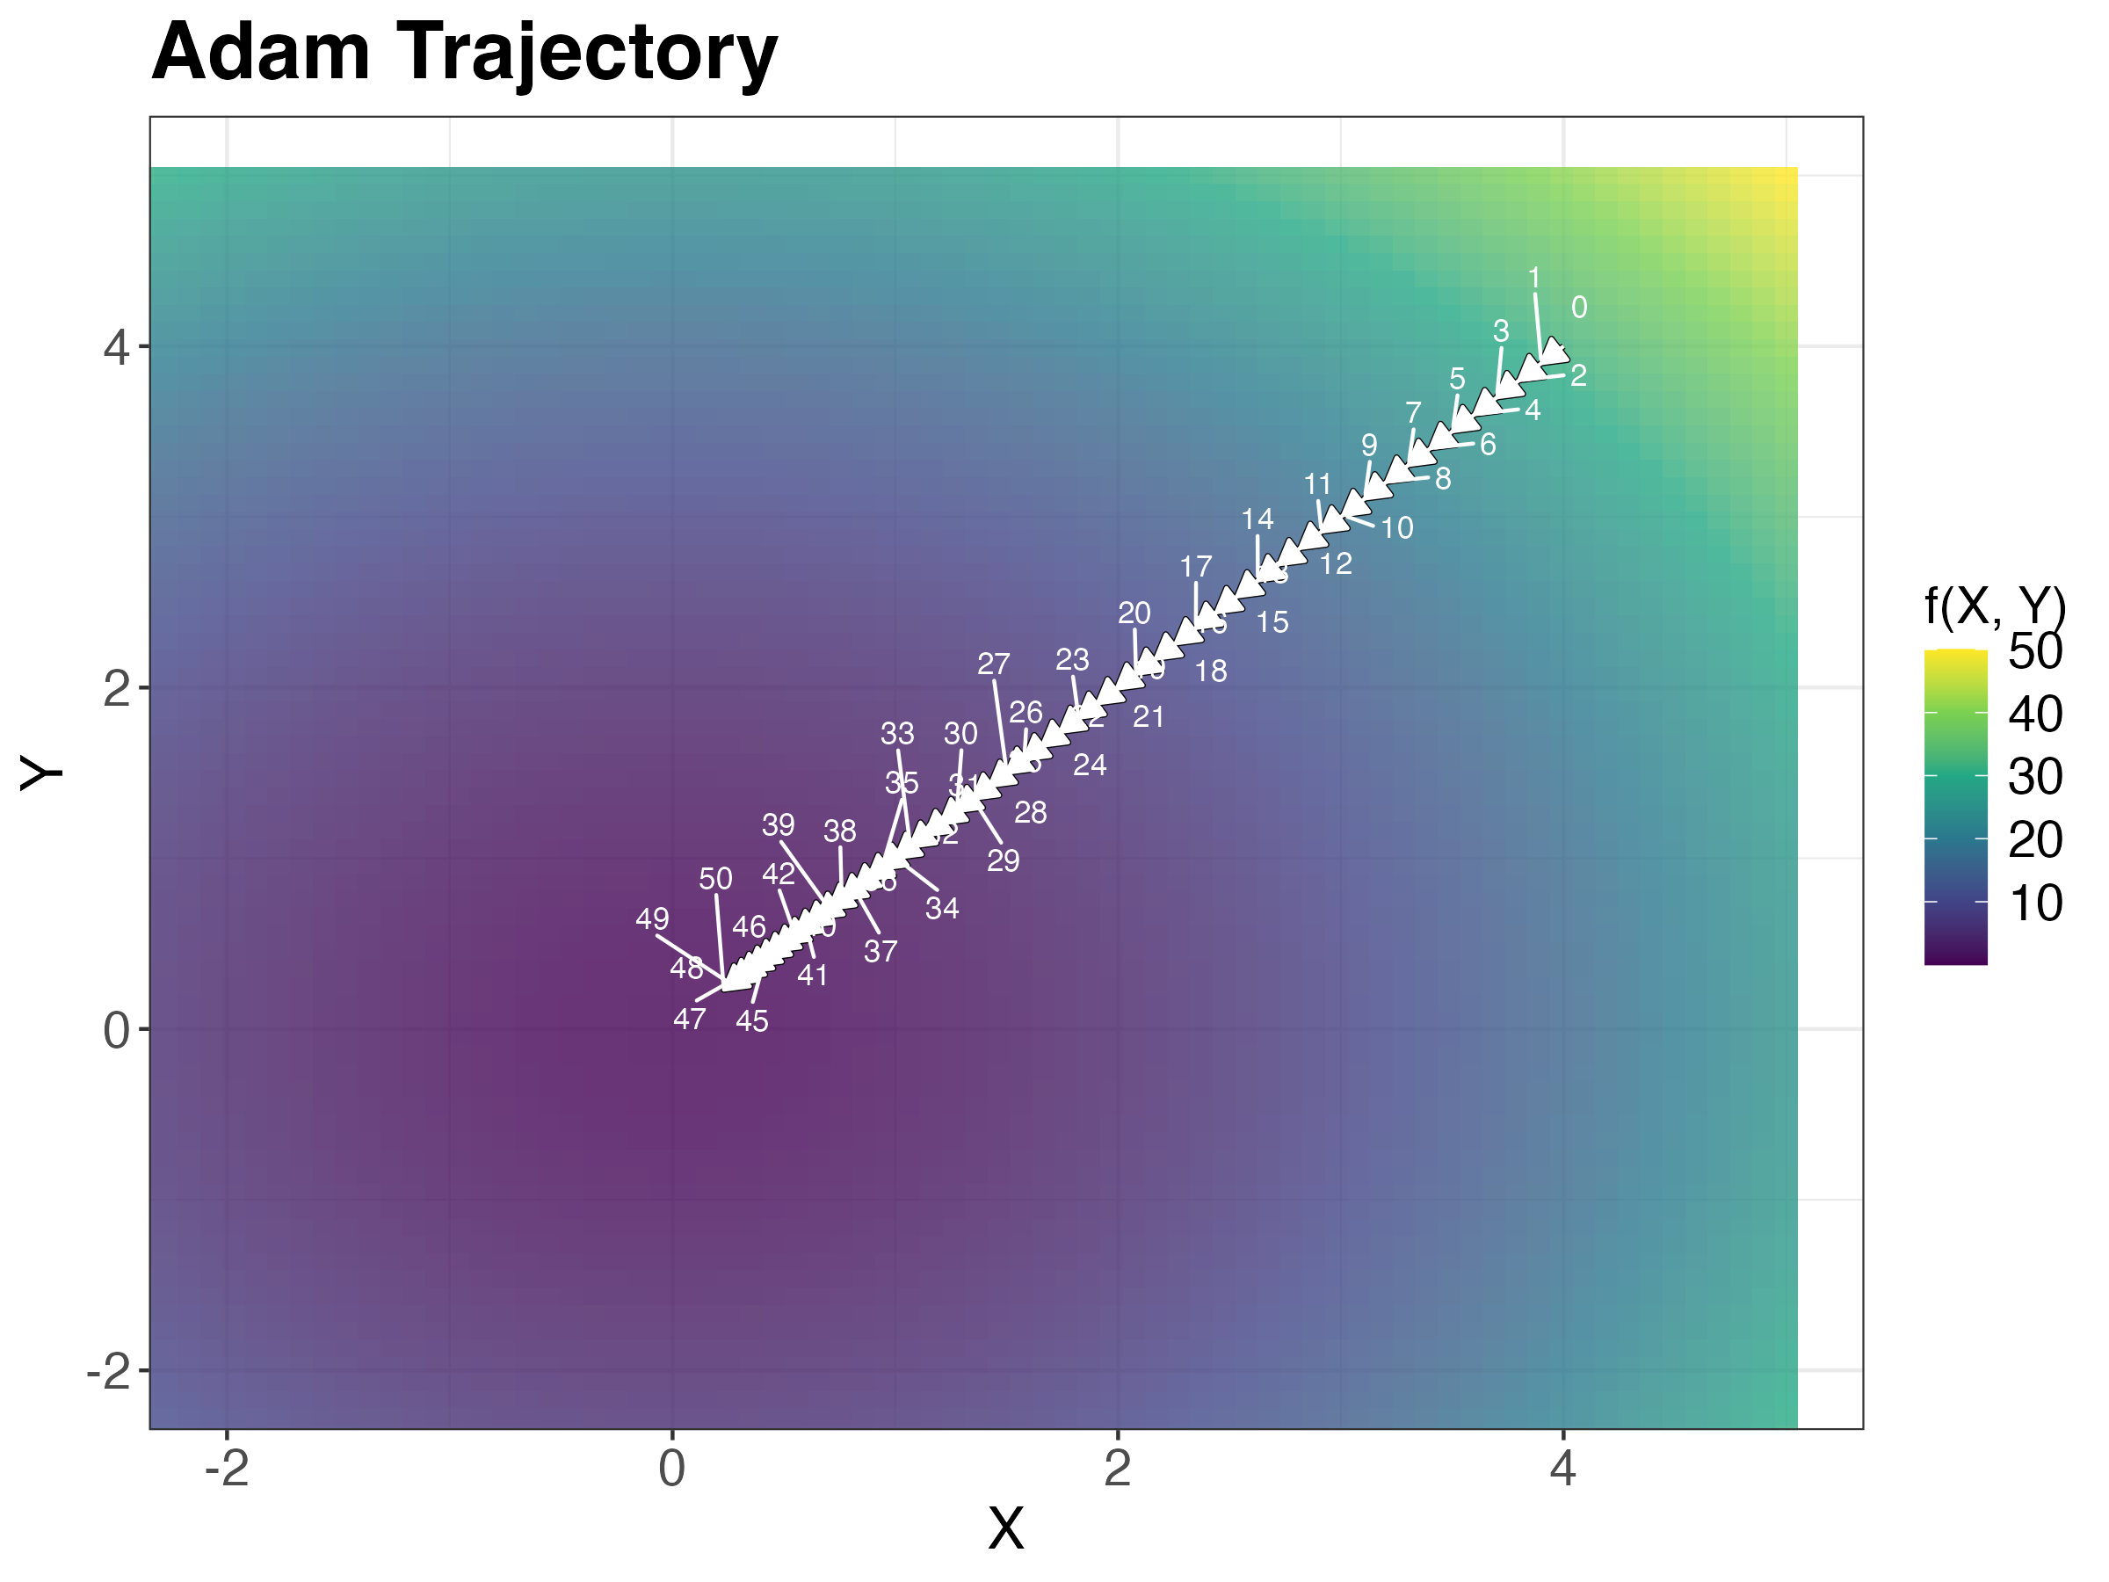

Deep Learning Optimizer Dynamics
Introduction
Visualizing the different optimizers behavior
Optimizers Behavior
Neural Networks : Neural networks are computational models inspired by the human brain, designed to recognize patterns and make predictions from data.
Optimizers are algorithms used in machine learning to update model parameters during training, minimizing the loss function and improving model performance.
Gradient Descent (GD): Updates parameters by moving in the direction of the steepest gradient, but can be slow and oscillatory—took 50 steps to reach the saddle point.
Stochastic Gradient Descent (SGD): Uses noisy estimates of the gradient based on random data subsets, causing more fluctuations—took 50 steps to reach the saddle point with noise.
Key Insights:
Adam: Fastest, most stable, handles saddle points.
Momentum: Smooths oscillations but may overshoot.
RMSProp: Effective for non-convex functions.
SGD: High variance, less efficient for complex landscapes.
AdaGrad: Good for sparse gradients but decays fast.
Applications:
Computer Vision: Image classification (Adam, RMSProp)
NLP: Text analysis (Adam, SGD)
Reinforcement Learning: Policy optimization (Adam)
Generative Models: GANs (Momentum, Adam)
Healthcare: Disease detection (AdaGrad)
Finance: Stock prediction (Adam, SGD)
A Visual Exploration of Gradient Descent Optimizers This project visualizes the performance of gradient descent optimizers-SGD, Momentum, AdaGrad, RMSProp, and Adam--on various loss surfaces. Each optimizer behaves differently, and their distinct behaviours can be effectively depicted through visualizations
Momentum: Accelerates gradients in the right direction by incorporating past gradients, leading to faster convergence—took 50 steps to reach the saddle point.
AdaGrad: Adapts the learning rate for each parameter, helping with sparse gradients, but may slow down over time—took 50 steps to reach the saddle point.
Conclusion:
Adam is the most efficient for general use.
Visualizing optimizer paths aids in understanding convergence.
Helps choose the best optimizer for specific tasks.
How Optimizers are Helpful: optimizers adjust model settings to minimize error, making training faster and more accurate while helping the model find the best solution.
RMSProp: Adjusts the learning rate for each parameter and smooths out oscillations, especially in noisy environments—took 50 steps to reach the saddle point with noise.
Adam: Combines momentum and adaptive learning rates, making it the most efficient for handling noise and complex surfaces—took 50 steps to reach the saddle point with noise.
Git Hub: https://github.com/INFO-526-FA24/project-2-stat-squad
Team Stat Squad: Prasanth Gubbala , Xenia De Gracia , Rishab RK ,Prudhvi Kandregula

